Slide 1
Final Exam Review

Slide 2
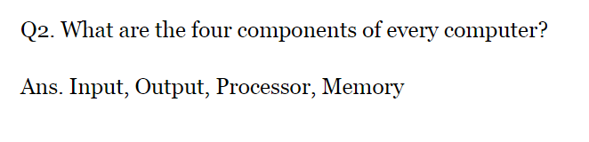
Intro to Comp Sci

Slide 3
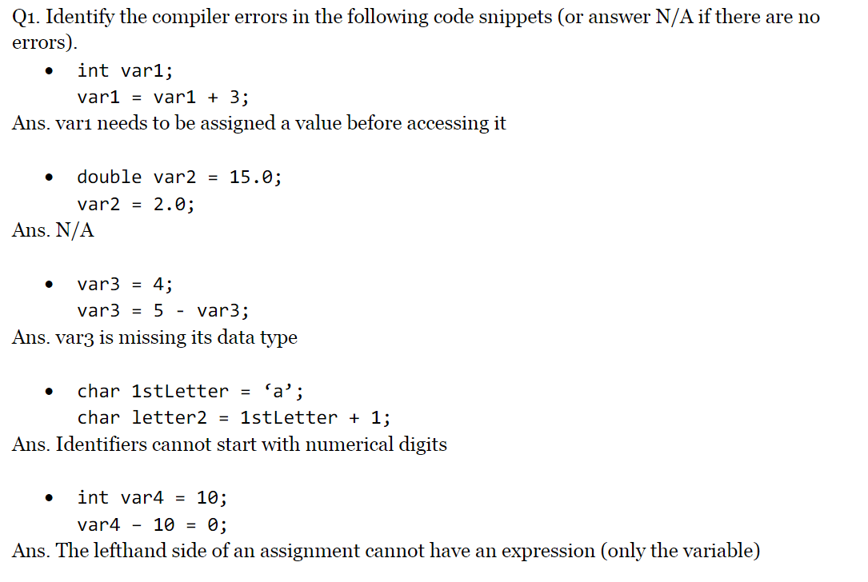
Variables and Arithmetic

Slide 4
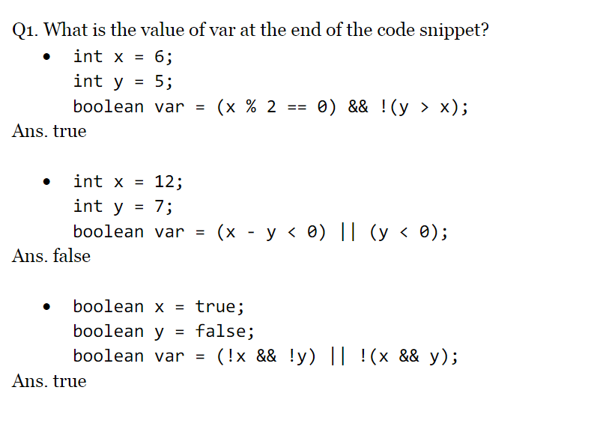
Program Control

Slide 5
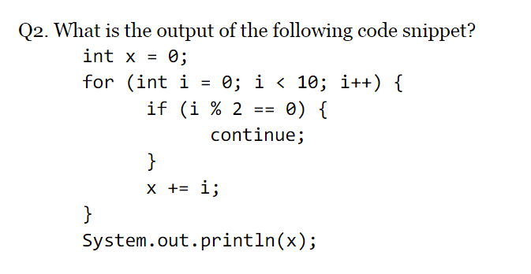
Program Control

Slide 6
Answer
25

Slide 7
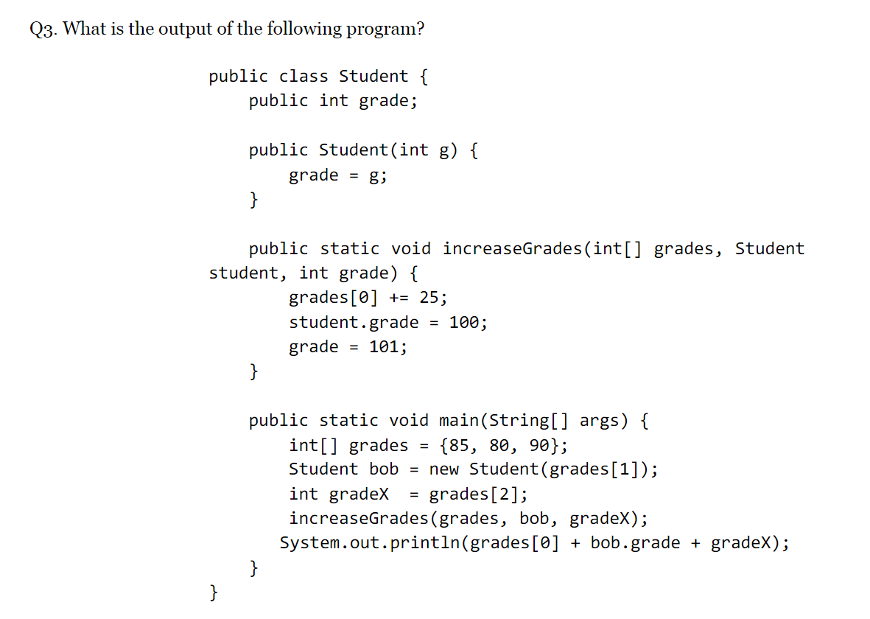
Methods and Number System Conversion

Slide 8
Answer
300

Slide 9
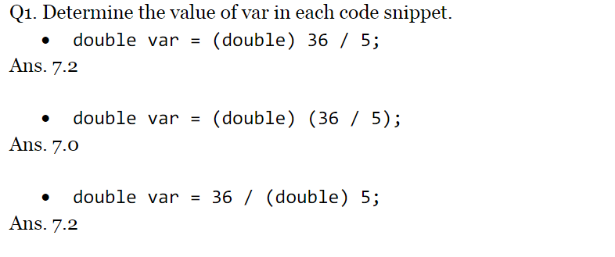
Data Types and String Methods

Slide 10
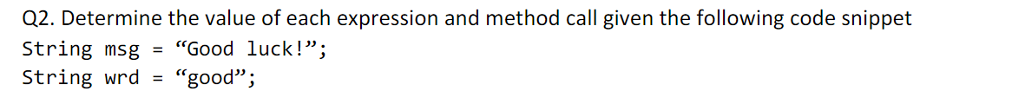
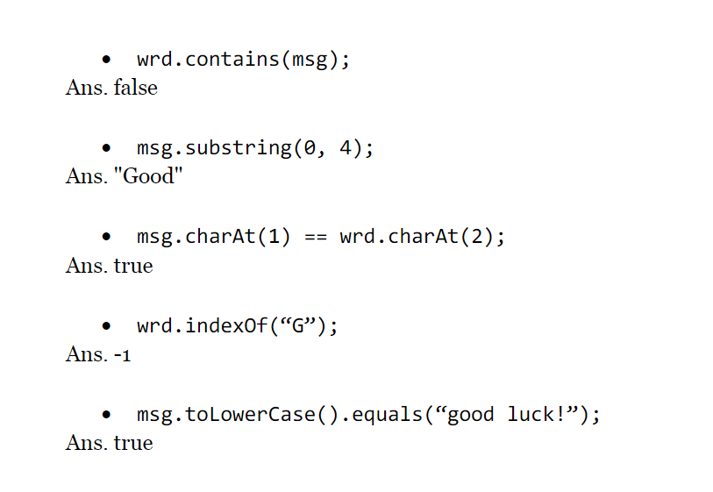

Slide 11
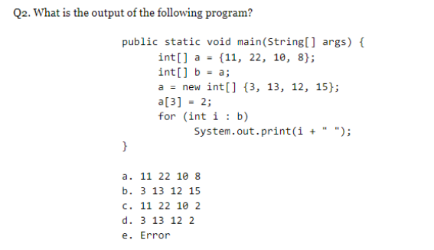
Methods and Arrays

Slide 12
Answer
11 22 10 8

Slide 13
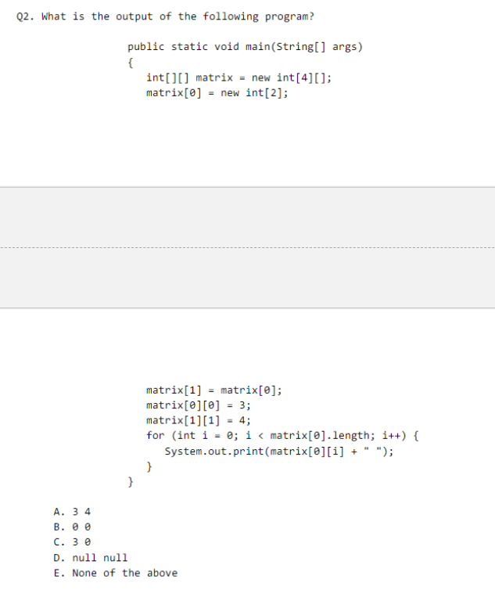

Slide 14
Answer -> 3 4

Slide 15
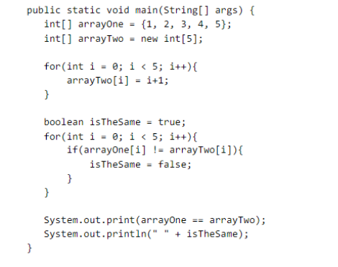

Slide 16

Answer

Slide 17
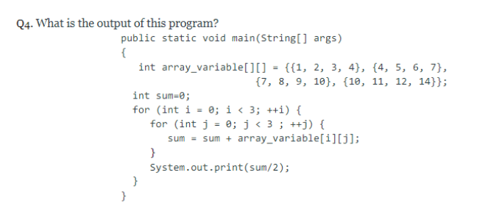

Slide 18
Answer->31022

Slide 19
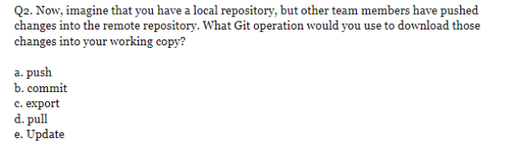
Software Engineering
Answer: D

Slide 20
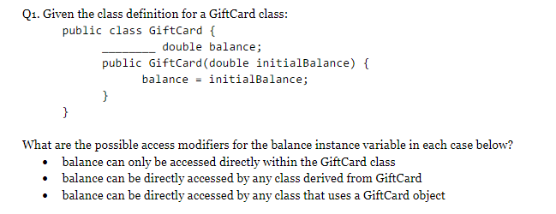
Classes

Slide 21
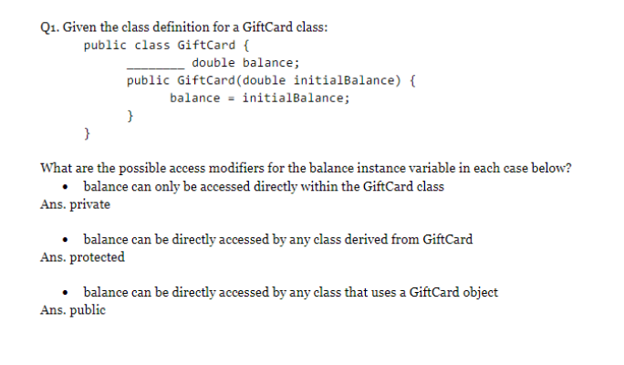
Answer

Slide 22
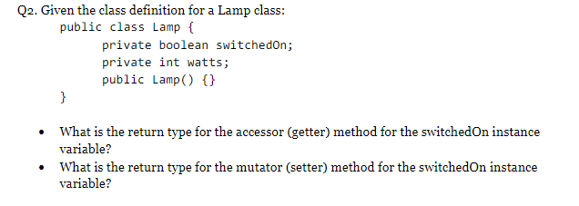
Classes

Slide 23
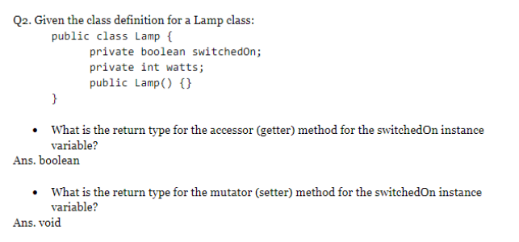
Answer

Slide 24
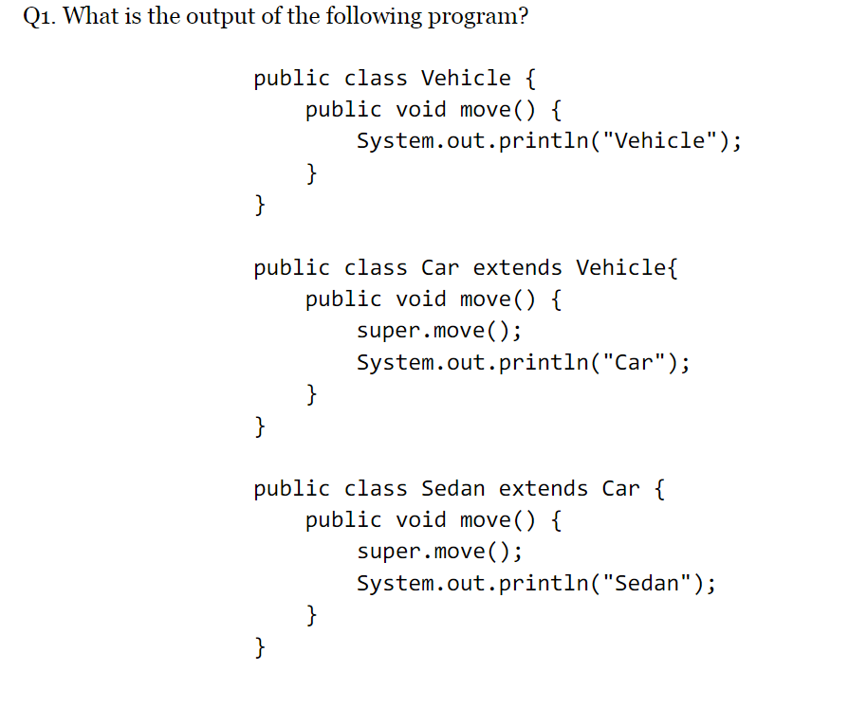
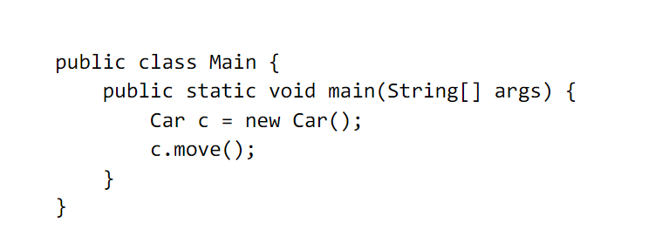
Inheritance

Slide 25
Answer
Vehicle
Car

Slide 26
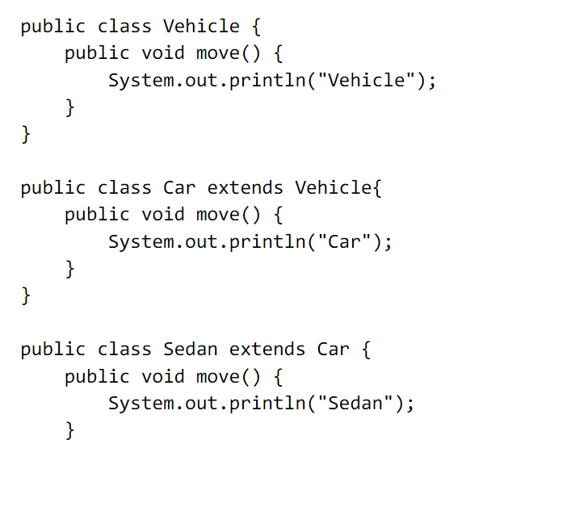
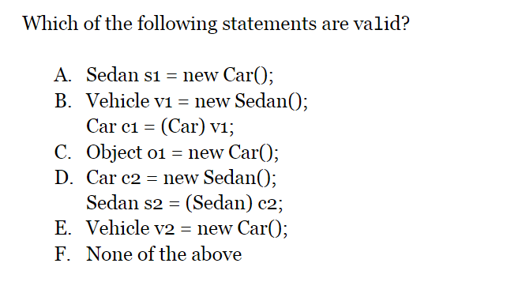

Slide 27
Answer
B,C,D,E

Slide 28
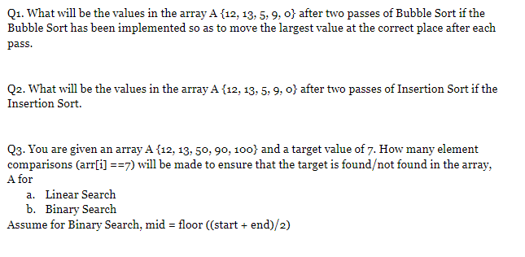
Searching and Sorting Algorithms

Slide 29
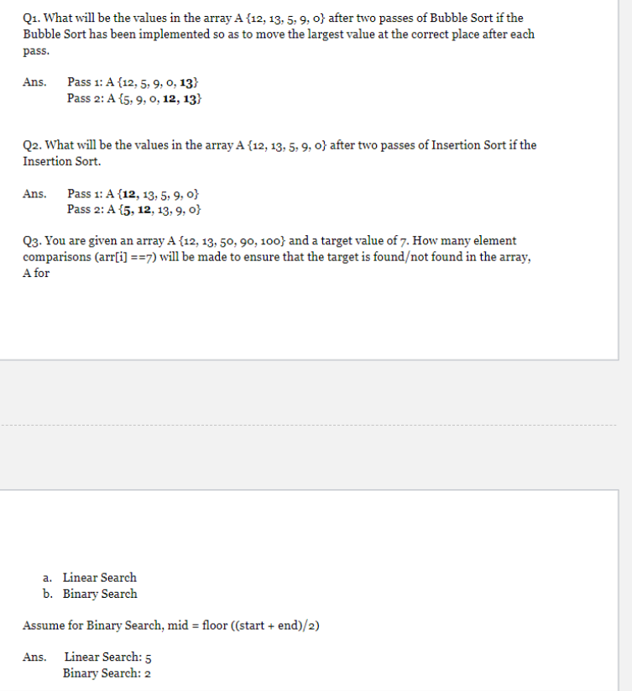
Answers:

Slide 30
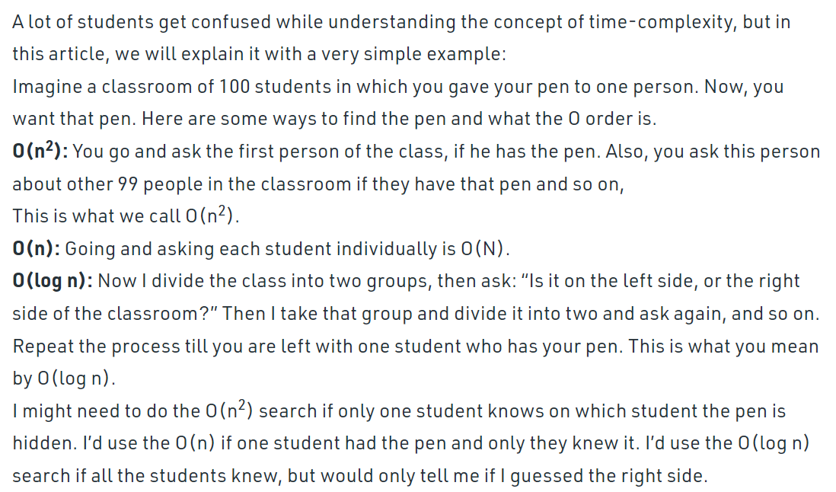
Time Complexity Geeks for Geeks

Slide 31
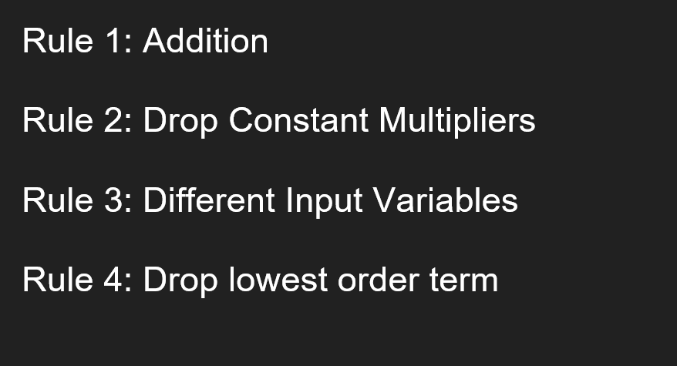
Rules for Analyzing Time Complexity

Slide 32
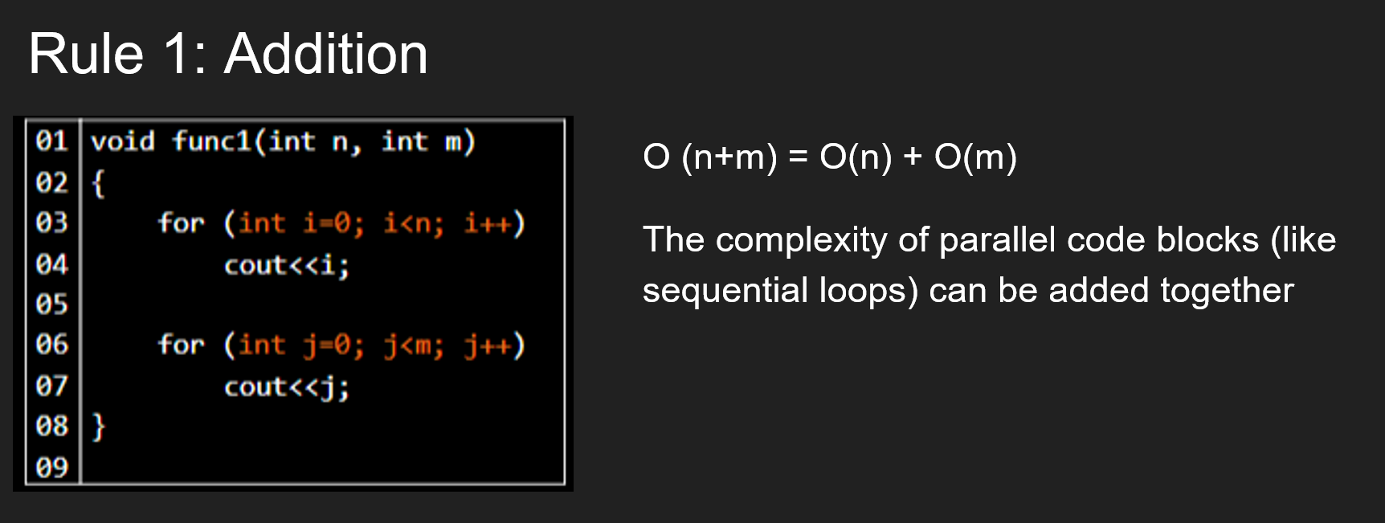

Slide 33
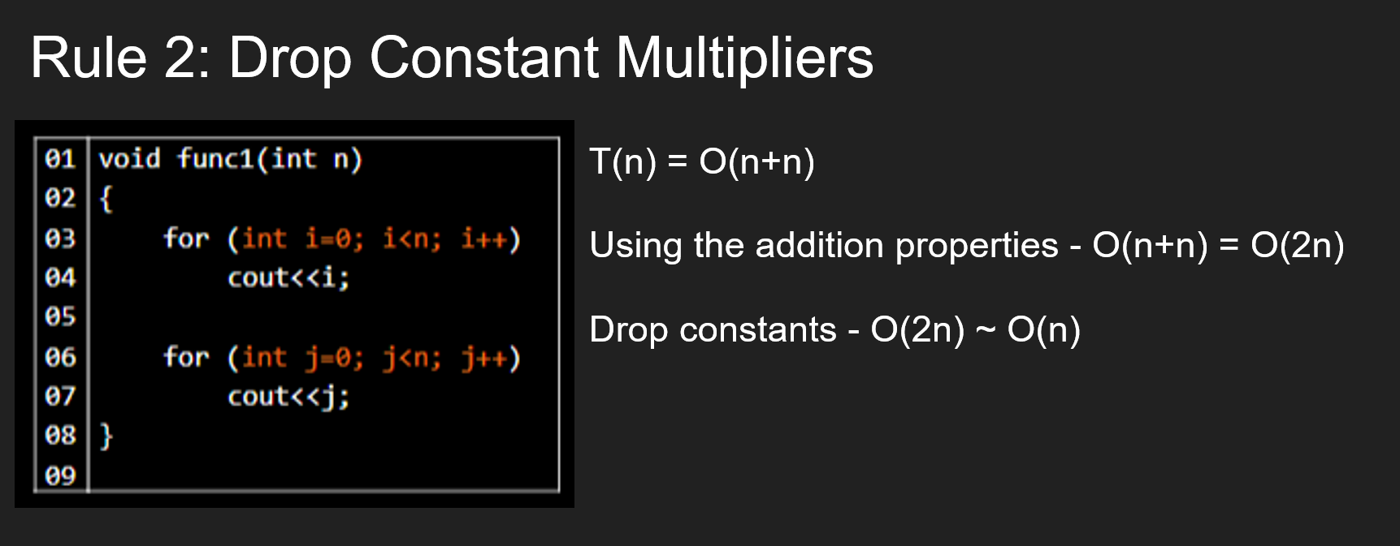

Slide 34
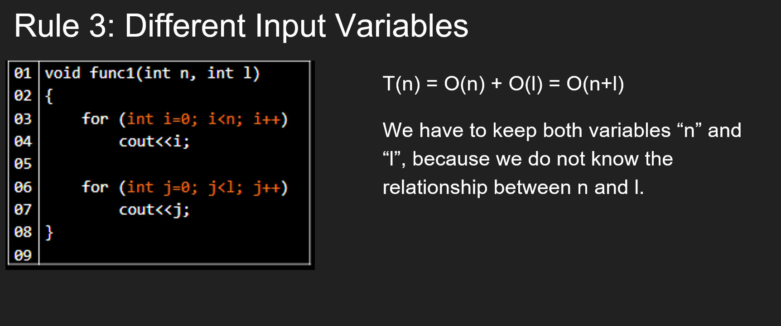

Slide 35
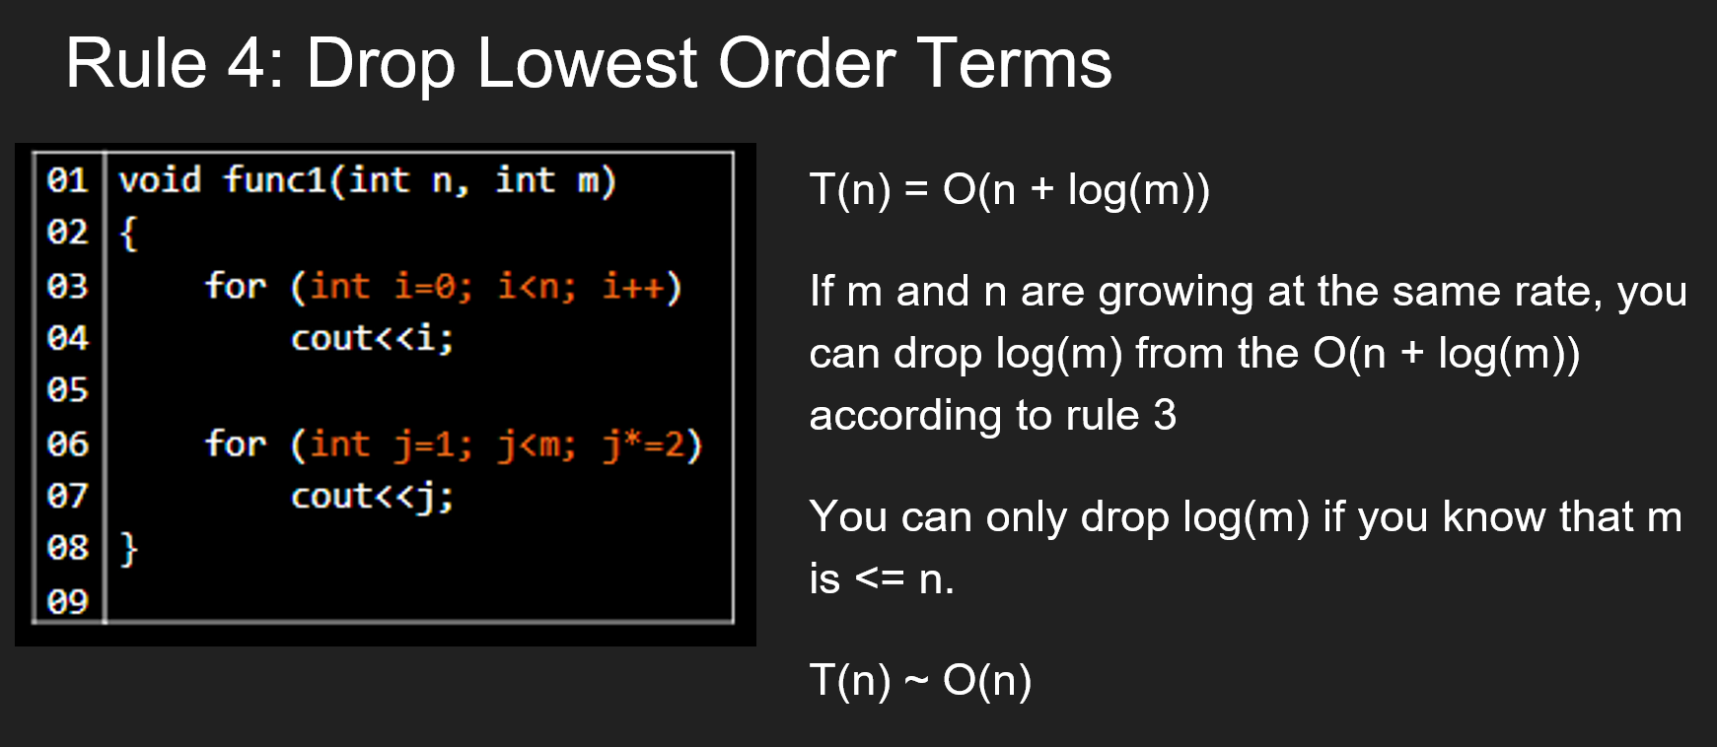

Slide 36
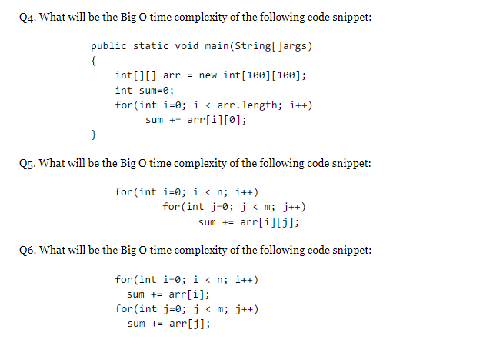
Time Complexity

Slide 37
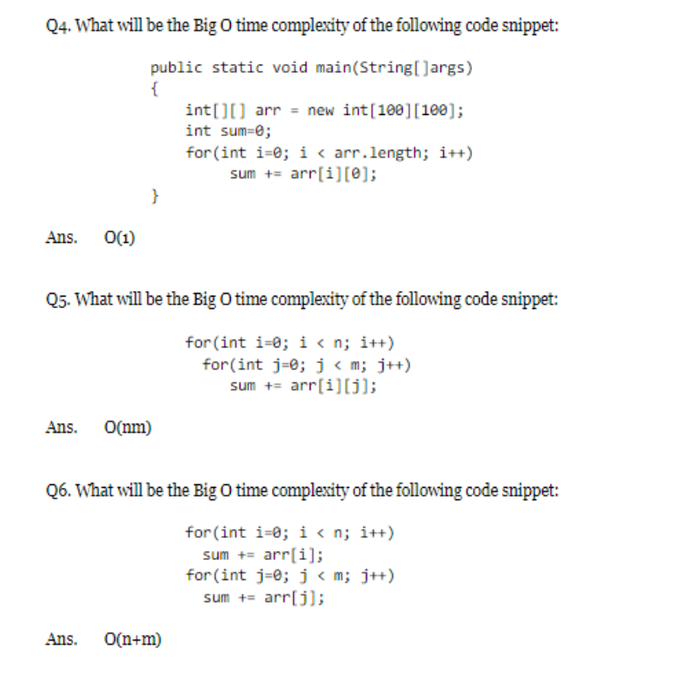
Answers

Slide 38
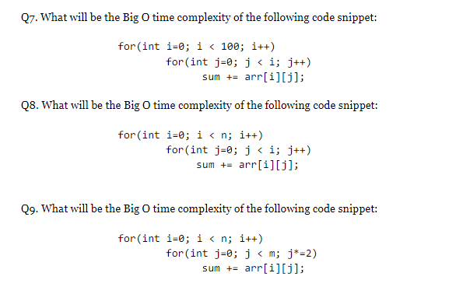
Time Complexity Pt.2

Slide 39
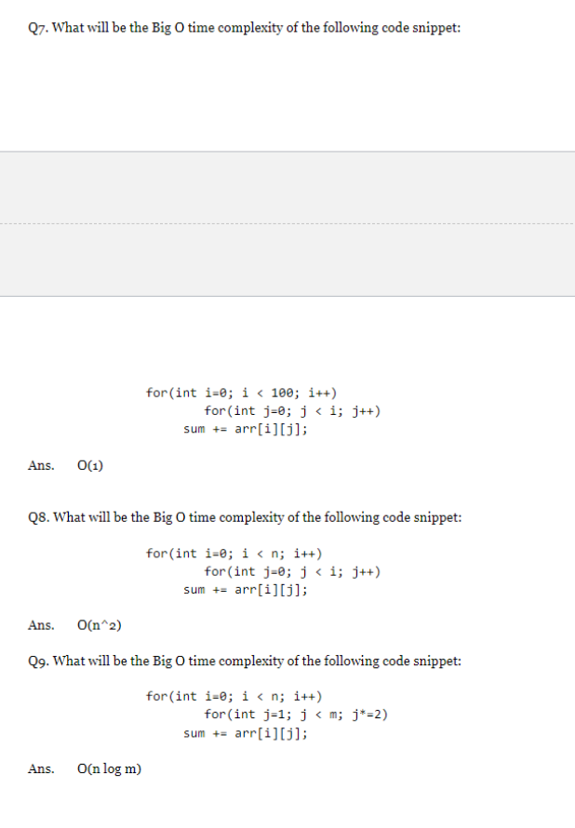
Answers:

Slide 40
More Time Complexity Resources
https://www.youtube.com/watch?v=9TlHvipP5yA
https://www.youtube.com/watch?v=9SgLBjXqwd4

